Slide 2
Missing Number Sequences
How could you work out the missing numbers?
Fill in the gaps.
12
?
20
24
?
?
36
16
28
32
8
24
48
?
16
?
32
40
?
56
64
600
700
1000
1100
?
800
900
?
?
400
350
?
?
?
?
100
300
250
200
150

Slide 3
Recognise the Place Value
of Each Digit in a Three-Digit Number
Write down the value of the red digit within each number.
78
70
101
0 (tens)
200
0
(ones)
380
300
591
1
732
30
111
10
902
2
555
640
600

Slide 4
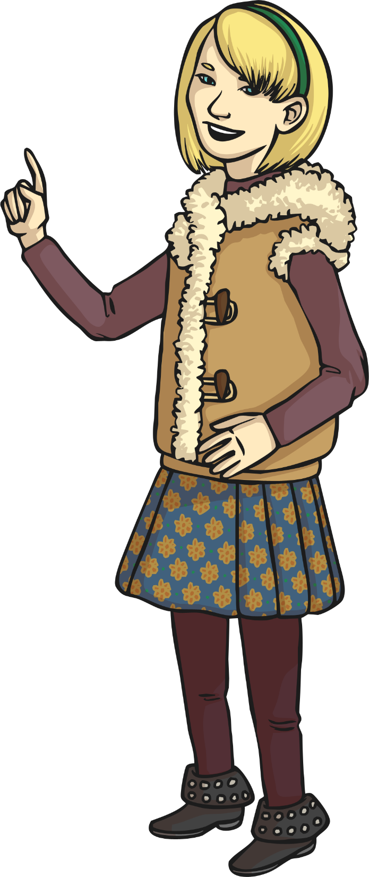
Recognise the Place Value of Each
Digit in a Three-Digit Number Reasoning Challenge
Which is greater - 908 or 809?
Convince me that your answer is correct.

Slide 5
Recognise the Place Value of
Each Digit in a Three-Digit Number
Partition these numbers into hundreds, tens and ones.
208
567
319
?
200
?
8
?
500
?
7
?
0
?
60
?
300
?
9
?
10

Slide 6
Recognise the Place Value of
Each Digit in a Three-Digit Number
Partition these numbers into hundreds, tens and ones.
782
999
814
?
700
?
2
?
900
?
9
?
80
?
90
?
800
?
4
?
10

Slide 7
Compare Numbers up to 1000
Look at this example. The symbol tells us that 77 is greater than 70.
77
>
70
Now write the correct sign (< >) to compare each set of numbers.
330
?
>
303
717
?
<
771
99
<
?
199
809
?
890
<
431
?
>
341
654
?
>
653

Slide 8
Compare Numbers up to 1000 Reasoning Challenge
Convince me that I’ve made a mistake.
187 > 781

Slide 9
Order Numbers up to 1000
Order these numbers from smallest to largest.
What is the best way to start ordering numbers?
654
650
605
506
546
605
641
650
654
546
506
641

Slide 10
Order Numbers up to 1000
Reasoning Challenge
These numbers have been ordered from largest to smallest. Explain what is wrong and why, then correct the mistakes.
1000
1000
700
999
801
807
780
801
807
780
999
708
708
700

Slide 11
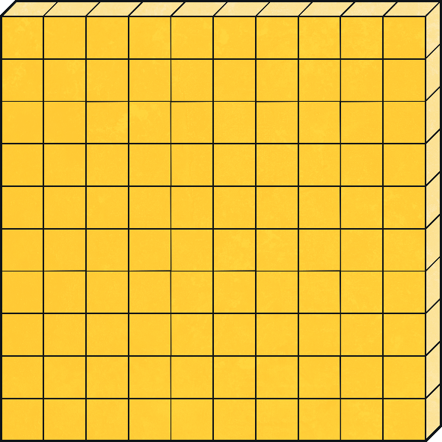
Identify Numbers Using Base 10
190
Click here for the answer

Slide 12
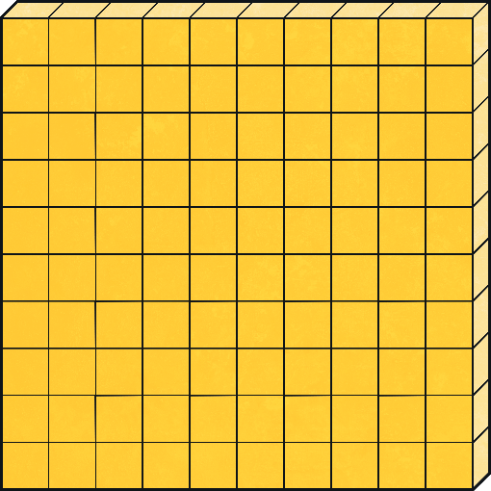
Identify Numbers Using Base 10
811
Click here for the answer

Slide 13
Identify Numbers Using Base 10 Drawings
Click on the number to reveal the answer.
132

Slide 14
Identify Numbers Using Base 10 Drawings
Click on the number to reveal the answer.
582

Slide 15
Identify Numbers Using Base 10 Drawings
Click on the drawing to reveal the answer.
909

Slide 16
Representing Numbers Using Base 10 Drawings
Complete Base 10 drawings for the following numbers:
84
200
460
811
Click on the circles to reveal the answer.

Slide 17
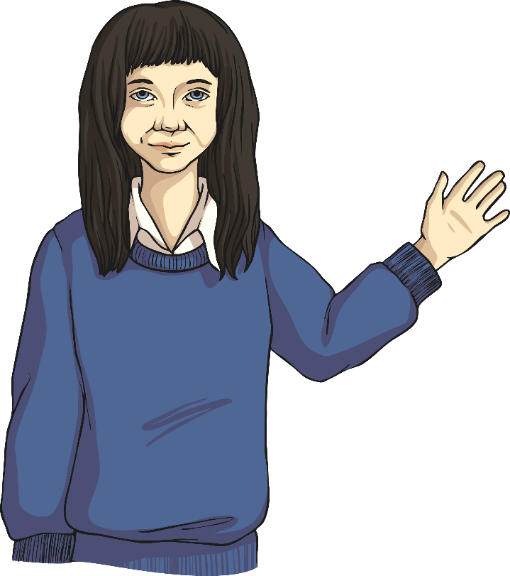
Estimating Numbers on a Number Line
420
?
0
1000
How do you go about working out the answer?

Slide 18
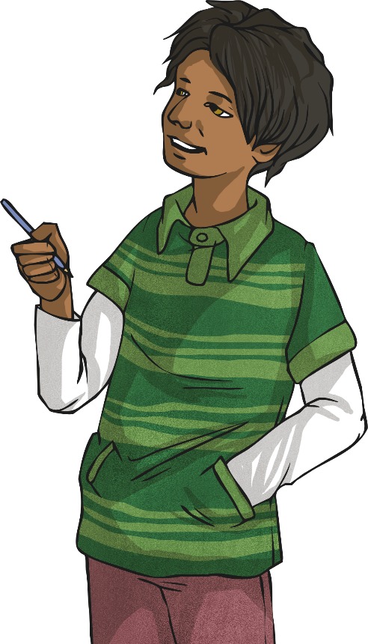
Estimating Numbers on a Number Line
32
?
0
1000
Explain how this answer was reached.

Slide 19
Estimating Numbers on a Number Line
Represent the following number on the number line.
800
700
1000

Slide 20
Estimating Numbers on a Number Line
Represent the following number on the number line.
399
300
450

Slide 21
Estimating: Measures
Estimate the height of this chair in centimetres.
100cm
A good estimate would be 50cm.
0cm

Slide 22
Estimating: Measures
Estimate the width of this table in centimetres.
0cm
100cm
A good estimate would be 105cm.

Slide 23
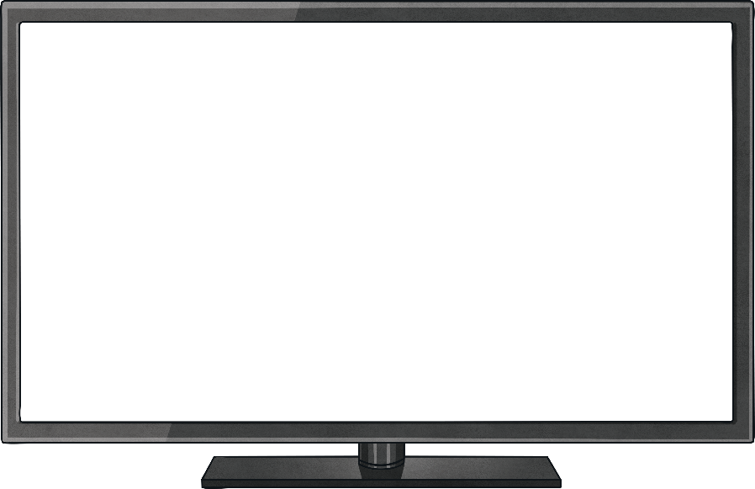
Estimating: Measures
Estimate the width of this television in centimetres.
0cm
100cm
A good estimate would be 75cm.

Slide 24
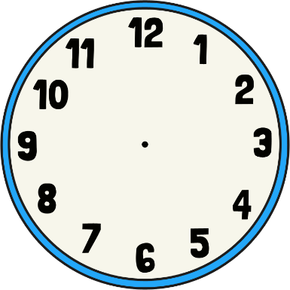
Estimating: Measures
Estimate the diameter of this clock in centimetres.
0cm
30cm
A good estimate would be 9cm.

Slide 25
Estimating: Measures
Estimate how much water is in the 1 litre measuring jugs.
Good Estimate:
500ml
?
Good Estimate:
150ml
?

Slide 26
Estimating: Measures
Estimate how much water is in the 1 litre measuring jugs.
Good Estimate:
330ml
?
Good Estimate:
100ml
?

Slide 27
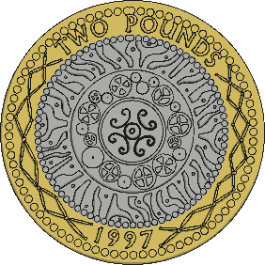
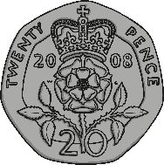
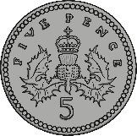
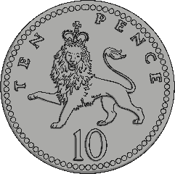
Estimating: Money
Which is a good estimate of how much money there is here?
Can you estimate how much money there was?
Click here to reveal the answer.
£5.40

Slide 28
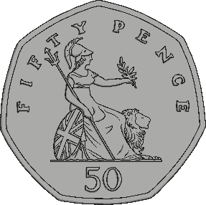
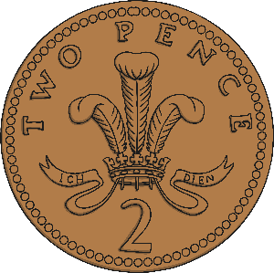
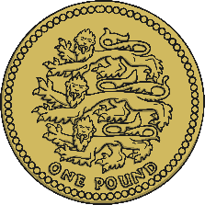
Estimating: Money
Which is a good estimate of how much money there is here?
Can you estimate how much money there was?
Click here to reveal the answer.
£4.27

Slide 29
Read Numbers up to 1000 in Numerals and Words
What is the correct written form for these numerals?
119
one hundred and ninety
one hundred and nineteen
one hundred and nine
one hundred and ninety-nine

Slide 30
Read Numbers up to 1000 in Numerals and Words
What is the correct written form for these numerals?
567
five hundred and sixty-seven
five hundred and seventy-six
five hundred and sixteen
five hundred and seventeen

Slide 31
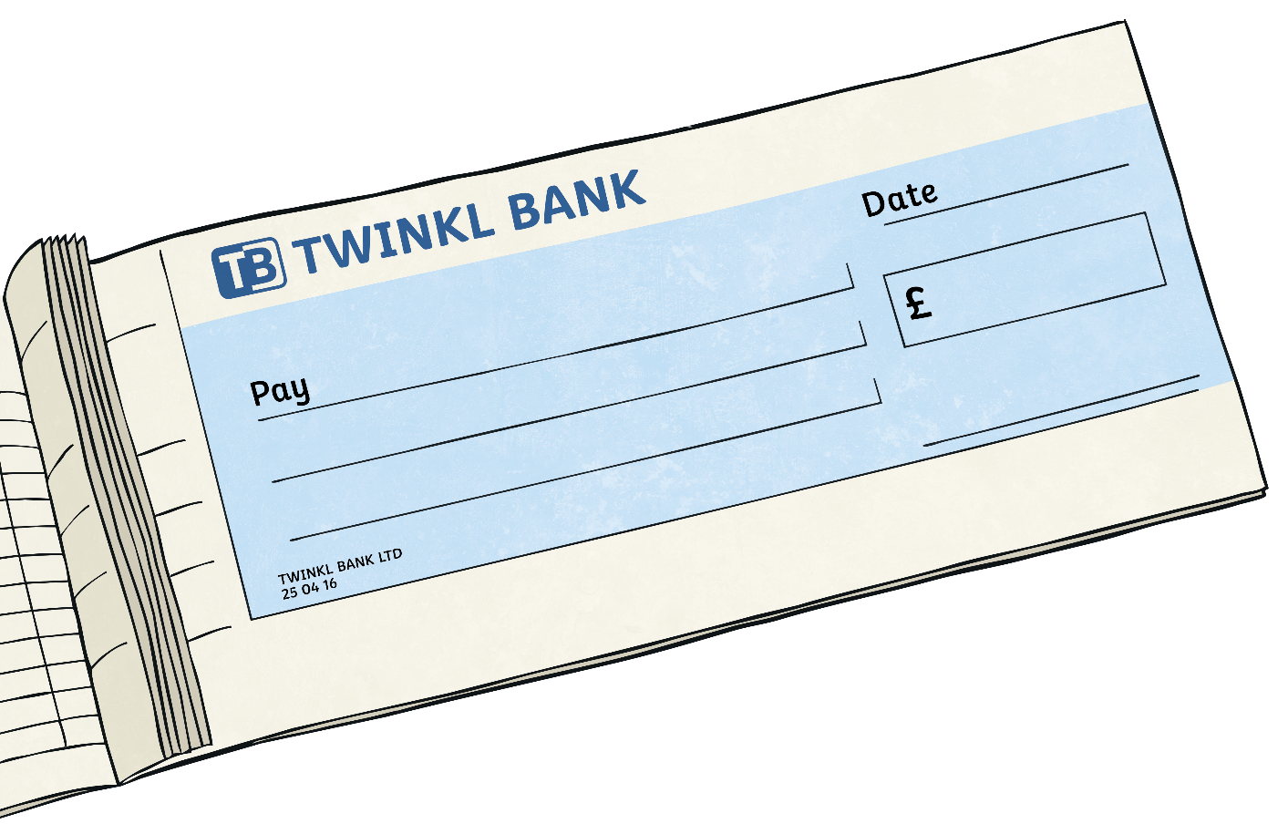
Read Numbers up to 1000 in Numerals and Words
Write the amount on the cheque in words.
812.24
eight hundred and twelve pounds and twenty-four pence

Slide 32
Read Numbers up to 1000 in Numerals and Words
Read the amounts in words then write the correct number in digits.
390.88
three hundred and ninety pounds and eighty-eight pence

Slide 33
Read Numbers up to 1000
Can you read these numbers?
123
234
345
456
567
678
898
987
101
202
303
404
505
606
707
808
909
1000
111
212
313
414
717
818
919
110
220
330
440
550
660
770
880
Choose one number from each column and write the number in words.

Slide 34
Read Numbers up to 1000
Answers to the first column:
One hundred and twenty-three
Two hundred and thirty-four
Three hundred and forty-five
Four hundred and fifty-six
Five hundred and sixty-seven
Six hundred and seventy-eight
Eight hundred and ninety-eight
Nine hundred and eighty-seven
One hundred and one
Two hundred and two
Three hundred and three

Slide 35
Read Numbers up to 1000
Answers to the second column:
Four hundred and four
Five hundred and five
Six hundred and six
Seven hundred and seven
Eight hundred and eight
Nine hundred and nine
One thousand
One hundred and eleven
Two hundred and twelve
Three hundred and thirteen
Four hundred and fourteen

Slide 36
Read Numbers up to 1000
Answers to the third column:
Seven hundred and seventeen
Eight hundred and eighteen
Nine hundred and nineteen
One hundred and ten
Two hundred and twenty
Three hundred and thirty
Four hundred and forty
Five hundred and fifty
Six hundred and sixty
Seven hundred and seventy
Eight hundred and eighty

Slide 37
Solve Number Problems and Practical Problems Involving These Ideas
Mrs Greggs sold 50 plums at the market. Estimate how many bananas were sold. Next, estimate how many oranges were sold.
50
plums
strawberries
oranges
bananas
Good estimation:
150 bananas
Good estimation:
25 oranges
How many bananas?
How many oranges?

Slide 38
Solve Number Problems and Practical Problems Involving These Ideas
Jamie wins a prize. He can choose prize box 1, 2 or 3.
Which should he choose?
1
2
3
£336.68
£363.86
£336.86
Why is that one better than the other two boxes?

Slide 39
Solve Number Problems and Practical Problems Involving These Ideas
Zain needs to cut a 44cm piece from this 2m length of wood, but he’s lost his tape measure to measure it out accurately.
Estimate where he will need to saw the wood.

Slide 40
Solve Number Problems and Practical Problems Involving These Ideas
Estimate Cody’s height in metres and centimetres.
2m
Good Estimate:
1m 10cm
0m

